Slide 1
Plan-DO-Study-ACT (PDSA)
Introduction
JJSG Results Count® Program
January 2021

Slide 2
Scientific method meets Action Learning meets Lean Method
Model for Improvement
What are we trying to accomplish?
How will we know that a change is an improvement?
Three simple questions
What change can we make that will result in improvement?
Team based
Real work setting
Focused on a test of change (the “do” is
for real!)
Act
Plan
Study
Do
The PDSA CYCLE
Adapted by IHI from The Model for Improvement,* developed by Associates in Process Improvement

Slide 3
Establish measures
How will we know that a change is an improvement?
Key pivot here: PDSA uses quantitative measures to DETERMINE if specific change results in an improvement.
Data is not used descriptively. It is collected in close-to-real time to assess impact in the small test of change.

Slide 4
Selecting changes
What change can we make that will result in improvement?
This is the hypothesis: “If we do X, Y will happen.” Let’s test that!
Ideas for test of change can come from those close to the work or those who have made change.

Slide 5
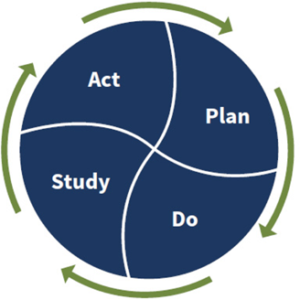
Testing changes: implementing the PDSA cycle
The Plan-Do-Study-Act (PDSA) tests a change in a
real setting—organizational or community
Steps are:
Plan it
Try it
Observe the results
Act on what’s learned
Acting on what’s learned: usually there’s a series of PDSA Cycles involved in refining the needed change. Once that’s achieved, the team can implement the change at a bigger scale (a whole unit, an entire pilot population), still using the PDSA frame.
Once that level of change implementation is successful, the change can be spread more broadly.

Slide 6
PDSA worksheet
BACKGROUND: What led you to start this project? Is this cycle a continuation of another cycle? Why is this topic relevant? Include any baseline data that has already been collected. Include relevant information from literature.

Slide 7
Plan
Aim/Objective Statement for this cycle: What do you hope to learn? What are you trying to improve (aim), by how much (goal) and by when (timeframe)?
Specific questions to address in this cycle:
1.
2.
3.
Predictions/Hypotheses (What do you think will happen?)
Plan for change/test/intervention
Who (target population):
What (change/test):
When (dates of test):
Where (location):
How (description of plan):

Slide 8
PDSA worksheet cont.
Measures (What will you measure in order to meet your aims? How will you know that a change is an improvement? Will you use outcome or process measures?)
Plan for data collection
Who (will collect):
What (measures):
When (time period):
Where (location):
How (method):

Slide 9
PDSA worksheet cont.
DO: Carry out the change/test. Collect data.
Note when completed, observations, problems encountered, and special circumstances. Include names and details.
STUDY: Summarize and Analyze data (quantitative and qualitative). Include charts, graphs.

Slide 10
PDSA worksheet cont.
ACT: Document/summarize what was learned. Did you meet your aims and goals? Did you answer the questions you wanted to address? List major conclusions from this cycle.
1.
2.
3.
Define next steps. Are you confident that you should expand size/scope of test or implement? What changes are needed for the next cycle?
1.
2.
3.

